Slide 1
Covariance Models for RNA Analysis
Bioinformatics & Computational Biology
Larry, Davis, Shane K. Dooley, Zach Lozier, Colleen Yanarella

Slide 2
Outline
HMMs
Biology Applications
Profile HMMs
Forward Algorithm
Questions

Slide 3
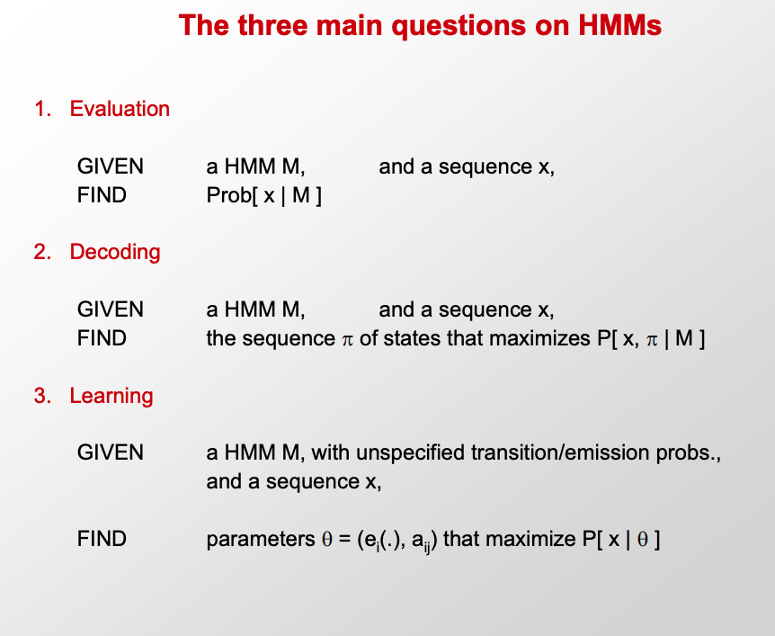
Notes:
Learning = re-estimate the parameters of the model based on training data
Evaluation =
1. P(x) Probability of x given the model P(xi…xn)
2. Probability of a substring of x given the model
3. P(Z_i = k | X) Probability that the ith state is k, given x A more refined measure of which states x may be in

Slide 4
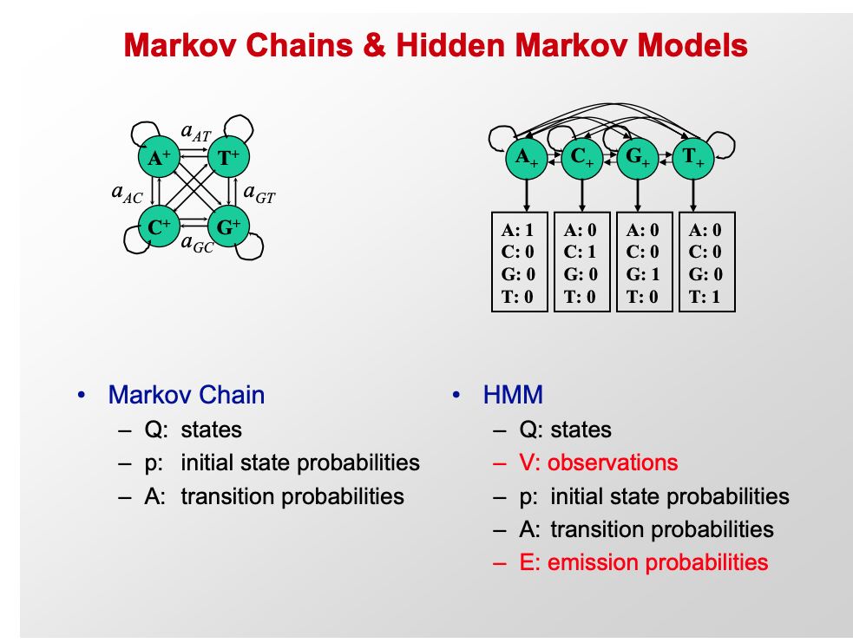
Hidden Markov Models (HMMs)

Slide 5
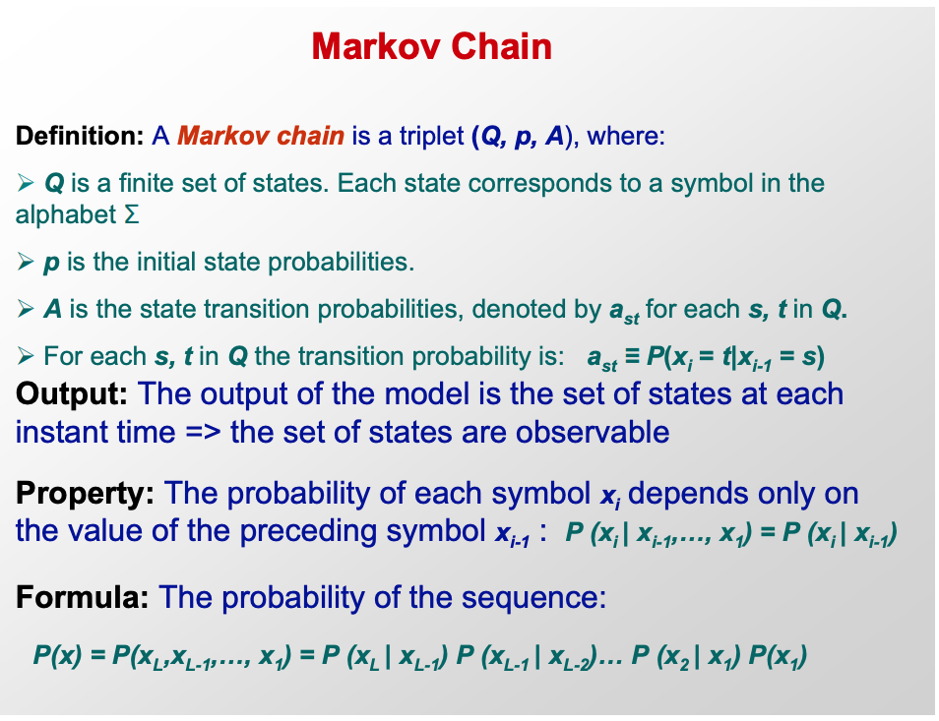

Slide 6
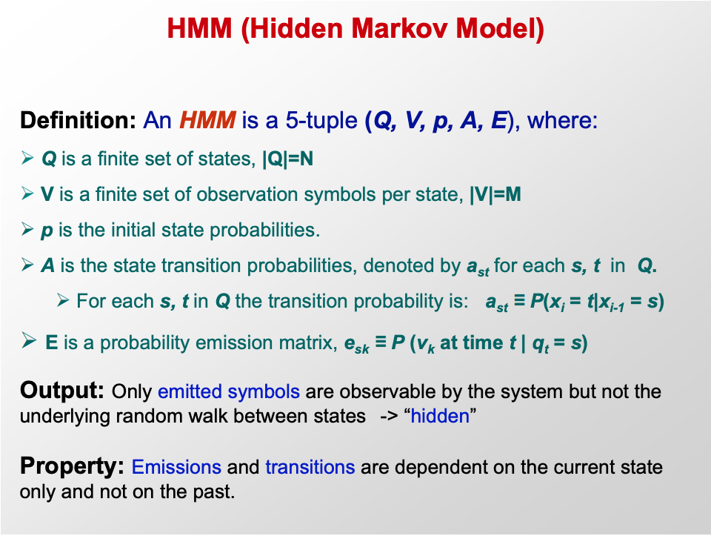

Slide 7
Biological Applications
Annotation
DNA,RNA, or protein identification
Classification
Species identification
Consensus
Motif finding
Training
Given a set of observations and a model structure -> Emission and Transition probabilities

Slide 8
Gene Anatomy
Notes:
Image from: https://www.britannica.com/science/gene/media/228226/114928
Genes are discontinous the portions that contribute to the end product (coding regions) are called exons, regions that are not are called introns

Slide 9
Problems
We don’t know the distribution for:
initial states
transition probabilities
emission probabilities
Given the above, we don’t know the most likely state space of each observation
Notes:
We don’t know these things, but luckily, we have learned about Expectation Maximization so we can solve that using a special case of an EM called the Baum-Welch algorithm and then

Slide 10
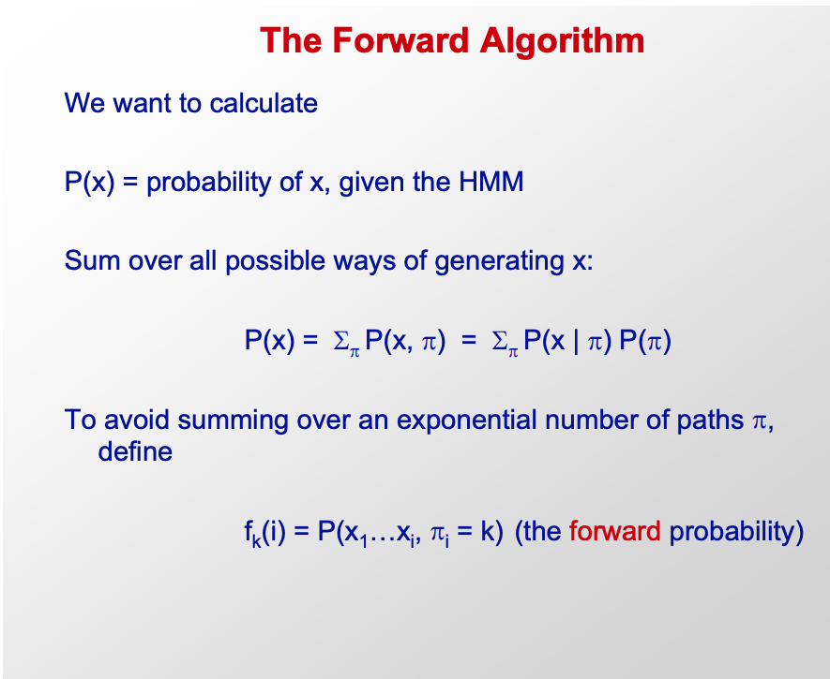

Slide 11
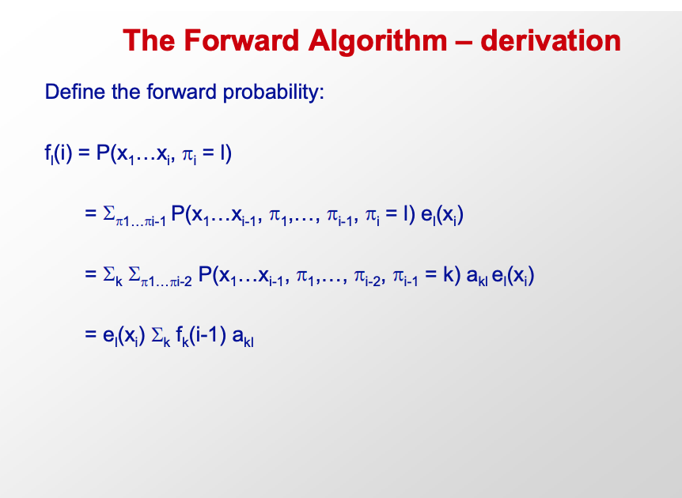

Slide 12
